Slide 1
Query Processing and Optimization

Slide 2
Introduction
Users are expected to write “efficient” queries. But they do not always do that!
Users typically do not have enough information about the database to write efficient queries. E.g., no information on table size
Users would not know if a query is efficient or not without knowing how the DBMS’s query processor work
DBMS’s job is to optimize the user’s query by:
Converting the query to an internal representation (tree or graph)
Evaluate the costs of several possible ways of executing the query and find the best one.

Slide 3
Steps in Query Processing
SQL query
Join
Query Parsing
Employee
Project
Parse Tree
Join Employee and Project
using hash join, … ...
Query Optimization
Execution Plan
Code Generation
Runtime DB Processor
Result
Code

Slide 4
Query Processing
Query in a high level language
Scanning, Parsing,
& Validating
Intermediate form of query
QUERY OPTIMIZER
Execution Plan
Query Code Generator
Code to execute the query
Runtime DB Processor
Result of query

Slide 5
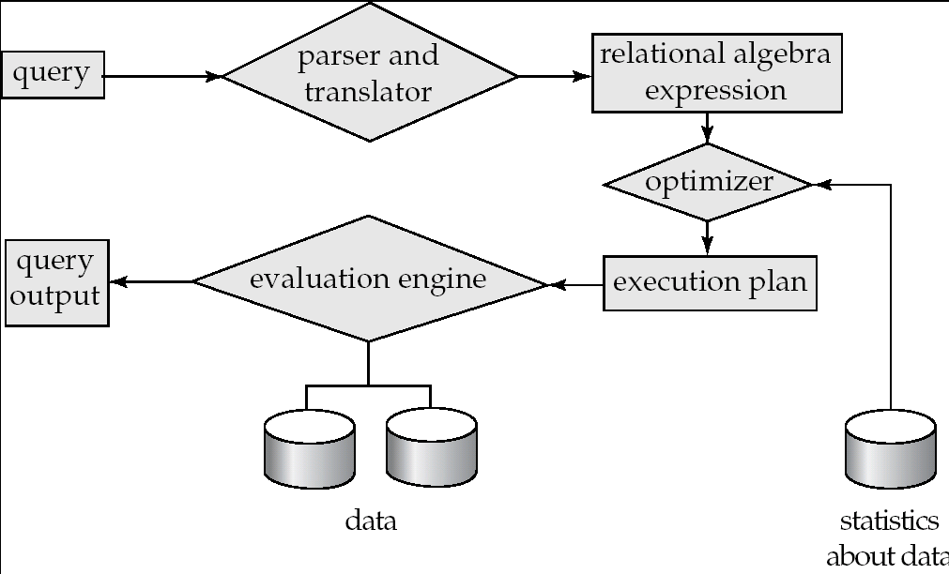
Basic Steps in Query Processing
1. Parsing and translation
2. Optimization
3. Evaluation

Slide 6
Basic Steps in Query Processing
Parsing and translation
translate the query into its internal form. (relational algebra)
Parser checks syntax, verifies relations
Evaluation
The query-execution engine takes a query-evaluation plan, executes that plan, and returns the answers to the query.

Slide 7
Query Processing
Consider the query:
select balance
from account
where balance<2500
Can be translated into either of the following RA expressions:
σ_{balance<2500}(∏_{balance}(account)) ∏_{balance}(σ_{balance<2500}(account))
The RA expressions are equivalent

Slide 8
Query Processing
Each relational algebra operation can be evaluated using one of several different algorithms
Correspondingly, a relational-algebra expression can be evaluated in many ways.
Annotated expression specifying detailed evaluation strategy is called an evaluation-plan
E.g., can use an index on balance to find accounts with balance < 2500,
or can perform complete relation scan and discard accounts with balance ≥ 2500

Slide 9
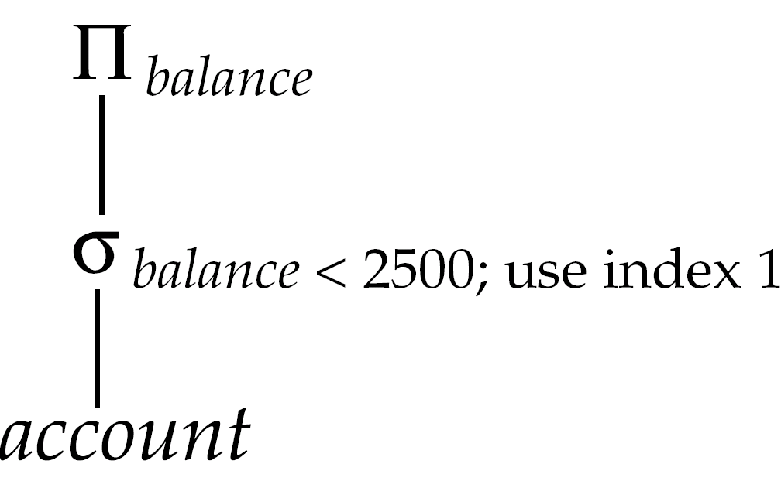
Query Plan

Slide 10
Query Optimization
Amongst all equivalent evaluation plans choose the one with lowest cost.
Cost is estimated using statistical information from the database catalog
e.g. number of tuples in each relation, size of tuples, etc.
First we need to learn:
How to measure query costs
Algorithms for evaluating relational algebra operations
How to combine algorithms for individual operations in order to evaluate a complete expression
How to optimize queries, that is, how to find an evaluation plan with lowest estimated cost

Slide 11
Measures of Query Cost
Cost is generally measured as total elapsed time for answering query
Many factors contribute to time cost
disk accesses, CPU, or even network communication
Typically disk access is the predominant cost, and is also relatively easy to estimate. Measured by taking into account
Number of seeks * average-seek-cost
+ Number of blocks read * average-block-read-cost
+ Number of blocks written * average-block-write-cost
Cost to write a block is greater than cost to read a block
data is read back after being written to ensure that the write was successful
Assumption: single disk
Can modify formulae for multiple disks/RAID arrays
Or just use single-disk formulae, but interpret them as measuring resource consumption instead of time

Slide 12
Measures of Query Cost (Cont.)
For simplicity we just use the number of block transfers from disk and the number of seeks as the cost measures
t_{T} – time to transfer one block
t_{S} – time for one seek
Cost for b block transfers plus S seeks b * t_{T} + S * t_{S}
We ignore CPU costs for simplicity
Real systems do take CPU cost into account
We do not include cost to writing output to disk in our cost formulae
Several algorithms can reduce disk I/O by using extra buffer space
Amount of real memory available to buffer depends on other concurrent queries and OS processes, known only during execution
We often use worst case estimates, assuming only the minimum amount of memory needed for the operation is available
Required data may be buffer resident already, avoiding disk I/O
But hard to take into account for cost estimation

Slide 13
Statistics and Catalogs
For each Table
Table name, file name (or some identifier) & file structure (e.g., heap file)
Attribute name and type of each attribute
Index name of each index
Integrity constraints
For each Index
Index name & the structure (e.g., B+ tree)
Search key attributes
For each View
View name & definition
Notes:
8

Slide 14
Statistics and Catalogs
Cardinality: NTuples(N) for each R
Size: NPages(R) for each R
Index Cardinality: Number of distinct key values NKeys(I) for each I
Index Size: INPages(I) for each index I
For B+ tree index, INPages is number of leaf pages
Index Height: Number of non-leaf levels IHeight(I) for eact tree index
Index Range: ILow(I) & IHigh(I)
Notes:
8

Slide 15
Statistics and Catalogs
Catalogs updated periodically
Updating whenever data changes is too expensive
More detailed information (e.g., histograms of the values in some field) are sometimes stored.
Notes:
8

Slide 16
Operator Evaluation
Algorithms for evaluating relational operators use some simple ideas extensively:
Indexing: If a selection or join condition is specified, use an index to examine just the tuples that satisfy the condition.
Iteration: Sometimes, faster to scan all tuples even if there is an index. (And sometimes, we can scan the data entries in an index instead of the table itself.)
Partitioning: By using sorting or hashing, we can partition the input tuples and replace an expensive operation by similar operations on smaller inputs.

Slide 17
Access Paths
An access path is a method of retrieving tuples:
File scan, or index that matches a selection (in the query)
A tree index matches (a conjunction of) terms that involve only attributes in a prefix of the search key.
E.g., Tree index on <a, b, c> matches the selection a=5 AND b=3, and a=5 AND b>6, but not b=3.
A hash index matches (a conjunction of) terms that has a term attribute = value for every attribute in the search key of the index.
E.g., Hash index on <a, b, c> matches a=5 AND b=3 AND c=5; but it does not match b=3, or a=5 AND b=3, or a>5 AND b=3 AND c=5.
Notes:
13

Slide 18
Access Paths
Selectivity: Number of pages retrieved (Index + data) to retrieve all desired tuples
Using the most selective access path minimizes the cost of data retrieval
Reduction Factor:
Each conjunct is a filter
Fraction of tuples satisfying a given conjunct is called the reduction factor
Notes:
13

Slide 19
Query Optimization
Techniques used by a DBMS to process, optimize, and execute high-level queries
A high-level query is
Scanned
Parsed
Validated
Internal representation
QUERY TREE
QUERY GRAPH
Many Execution Strategies
Choosing a suitable one for processing a query is QUERY OPTIMIZATION
Ideally: Want to find best plan
Practically: Avoid worst plans!

Slide 20
Query Optimization
Scanning
The scanner identifies the language tokens, such as SQL keywords, attribute names, & relation names
Parsing
Parser checks the query syntax to determine whether it is formulated according to the grammar rules of the query language
Validating
Checking that all the attribute & relation names are valid and semantically meaningful names in the schema of the particular DB being queried

Slide 21
SQL Queries to Relational Algebra
SQL queries are optimized by decomposing them into a collection of smaller units, called blocks
Query optimizer concentrates on optimizing a single block at a time

Slide 22
Translating SQL Queries into Relational Algebra
Query block: the basic unit that can be translated into the algebraic operators and optimized.
A query block contains a single SELECT-FROM-WHERE expression, as well as GROUP BY and HAVING clause if these are part of the block.
Nested queries within a query are identified as separate query blocks.
Aggregate operators in SQL must be included in the extended algebra.

Slide 23
Translating SQL Queries into Relational Algebra
SELECT LNAME, FNAME
FROM EMPLOYEE
WHERE SALARY > ( SELECT MAX (SALARY)
FROM EMPLOYEE
WHERE DNO = 5);
SELECT LNAME, FNAME
FROM EMPLOYEE
WHERE SALARY > C
SELECT MAX (SALARY)
FROM EMPLOYEE
WHERE DNO = 5
π_{LNAME, FNAME} (σ_{SALARY>C}(EMPLOYEE))
ℱ_{MAX SALARY} (σ_{DNO=5} (EMPLOYEE))

Slide 24
Measures of Query Cost (Cont.)
For simplicity we just use the number of block transfers from disk and the number of seeks as the cost measures
t_{T} – time to transfer one block
t_{S} – time for one seek
Cost for b block transfers plus S seeks b * t_{T} + S * t_{S}
We ignore CPU costs for simplicity
Real systems do take CPU cost into account
We do not include cost to writing output to disk in our cost formulae

Slide 25
Selection Operation
File scan
Algorithm A1 (linear search). Scan each file block and test all records to see whether they satisfy the selection condition.
Cost estimate = b_{r} block transfers + 1 seek =(b_{r} * t_{T} + t_{S} )
b_{r} denotes number of blocks containing records from relation r
If selection is on a key attribute, can stop on finding record
cost = (b_{r} /2) block transfers + 1 seek = (b_{r} /2)* t_{T} + t_{S}
Linear search can be applied regardless of
selection condition or
ordering of records in the file, or
availability of indices
Note: binary search generally does not make sense since data is not stored consecutively
except when there is an index available,
and binary search requires more seeks than index search

Slide 26
Selections Using Indices
Index scan – search algorithms that use an index
selection condition must be on search-key of index.
A2 (primary index, equality on key). Retrieve a single record that satisfies the corresponding equality condition
Cost = (h_{i} + 1) * (t_{T} + t_{S})
A3 (primary index, equality on nonkey) Retrieve multiple records.
Records will be on consecutive blocks
Let b = number of blocks containing matching records
Cost = h_{i} * (t_{T} + t_{S}) + t_{T} * b

Slide 27
Selections Using Indices
A4 (secondary index, equality on nonkey).
Retrieve a single record if the search-key is a candidate key
Cost = (h_{i} + 1) * (t_{T} + t_{S})
Retrieve multiple records if search-key is not a candidate key
each of n matching records may be on a different block
Cost = (h_{i} + n) * (t_{T} + t_{S})
Can be very expensive!
Notes:
27

Slide 28
Selections Involving Comparisons
Can implement selections of the form σ_{A≤V} (r) or σ_{A ≥ V}(r) by using
a linear file scan,
or by using indices in the following ways:
A5 (primary index, comparison). (Relation is sorted on A)
For σ_{A ≥ V}(r) use index to find first tuple ≥ v and scan relation sequentially from there
For σ_{A≤V} (r) just scan relation sequentially till first tuple > v; do not use index
A6 (secondary index, comparison).
For σ_{A ≥ V}(r) use index to find first index entry ≥ v and scan index sequentially from there, to find pointers to records.
For σ_{A≤V} (r) just scan leaf pages of index finding pointers to records, till first entry > v
In either case, retrieve records that are pointed to
requires an I/O for each record
Linear file scan may be cheaper

Slide 29
Implementation of Complex Selections
Conjunction: σ_{θ1}∧ _{θ2}∧. . . _{θn}(r)
A7 (conjunctive selection using one index).
Select a combination of θ_{i} and algorithms A1 through A7 that results in the least cost for σ_{θi} (r).
Test other conditions on tuple after fetching it into memory buffer.
A8 (conjunctive selection using composite index).
Use appropriate composite (multiple-key) index if available.
A9 (conjunctive selection by intersection of identifiers).
Requires indices with record pointers.
Use corresponding index for each condition, and take intersection of all the obtained sets of record pointers.
Then fetch records from file
If some conditions do not have appropriate indices, apply test in memory.

Slide 30
Algorithms for Complex Selections
Disjunction:σ_{θ1}∨ _{θ2} ∨. . . _{θn} (r).
A10 (disjunctive selection by union of identifiers).
Applicable if all conditions have available indices.
Otherwise use linear scan.
Use corresponding index for each condition, and take union of all the obtained sets of record pointers.
Then fetch records from file
Negation: σ_{¬θ}(r)
Use linear scan on file
If very few records satisfy ¬θ, and an index is applicable to θ
Find satisfying records using index and fetch from file

Slide 31
Select Operation
File scan − scan all records of the file to find records that satisfy selection condition
Binary search − when the file is sorted on attributes specified in the selection condition
Index scan − using index to locate the qualified records
Primary index, single record retrieval − equality comparison on a primary key attribute with a primary index
Primary index, multiple records retrieval − comparison condition <, >, etc. on a key field with primary index
Clustering index to retrieve multiple records
Secondary index to retrieve single or multiple records
Notes:
2
2

Slide 32
Conjunctive Conditions
OP1 AND OP2 (e.g., EmpNo=123 AND Age=30)
Conjunctive selection: Evaluate the condition that has an index created (i.e., that can be evaluated very fast), get the qualified tuples and then check if these tuples satisfy the remaining conditions.
Conjunctive selection using composite index: if there is a composite index created on attributes involved in one or more conditions, then use the composite index to find the qualified tuples
Composite
index
EmpNo Age
012 25
Complete Employee Records
123 30
Conjunctive selection by intersection of record pointers: if secondary indexes are available, evaluate each condition and intersect the sets of record pointers obtained.
Notes:
2
2
Connect to tutorial oriented presentation, and emphasize our approach

Slide 33
Conjunctive Conditions
When there are more than one attribute with an index:
use the one that costs least, and
the one that returns the smallest number of qualified tuple
selectivity of a condition − is the number of tuples that satisfy the condition divided by total number of tuples.
The smaller the selectivity, the fewer the number of tuples retrieved, and the higher the desirability of using that condition to retrieve the records.
Disjunctive select conditions: OP1 or OP2 are much more costly:
potentially a large number of tuples will qualify
costly if any one of the condition doesn’t have an index created
Notes:
2
2

Slide 34
Sorting
We may build an index on the relation, and then use the index to read the relation in sorted order. May lead to one disk block access for each tuple.
For relations that fit in memory, techniques like quicksort can be used. For relations that don’t fit in memory, external sort-merge is a good choice.

Slide 35
External Sort-Merge
Let M denote memory size (in pages).
Create sorted runs. Let i be 0 initially. Repeatedly do the following till the end of the relation: (a) Read M blocks of relation into memory (b) Sort the in-memory blocks (c) Write sorted data to run R_{i}; increment i. Let the final value of i be N
Merge the runs (next slide)…..

Slide 36
External Sort-Merge (Cont.)
Merge the runs (N-way merge). We assume (for now) that N < M.
Use N blocks of memory to buffer input runs, and 1 block to buffer output. Read the first block of each run into its buffer page
repeat
Select the first record (in sort order) among all buffer pages
Write the record to the output buffer. If the output buffer is full write it to disk.
Delete the record from its input buffer page. If the buffer page becomes empty then read the next block (if any) of the run into the buffer.
until all input buffer pages are empty:

Slide 37
External Sort-Merge (Cont.)
If N ≥ M, several merge passes are required.
In each pass, contiguous groups of M - 1 runs are merged.
A pass reduces the number of runs by a factor of M -1, and creates runs longer by the same factor.
E.g. If M=11, and there are 90 runs, one pass reduces the number of runs to 9, each 10 times the size of the initial runs
Repeated passes are performed till all runs have been merged into one.

Slide 38
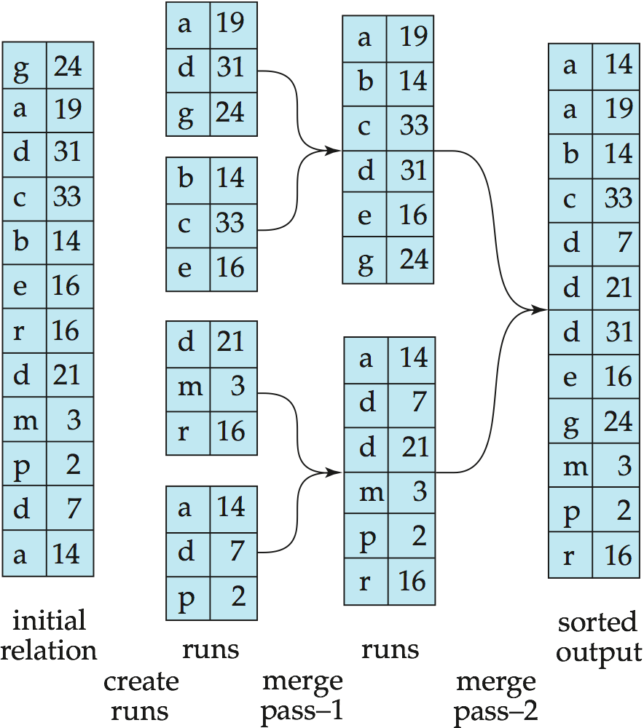
Example: External Sorting Using Sort-Merge

Slide 39
Join Operation
Join is one of the most time-consuming operations in query processing.
Two-way join is a join of two relations, and there are many algorithms to evaluate the join.
Multi-way join is a join of more than two relations; different orders of evaluating a multi-way join have different speeds
We shall study methods for implementing two-way joins of form R _{A=B} S
Notes:
2
2
Connect to tutorial oriented presentation, and emphasize our approach

Slide 40
Join Algorithm: Nested (inner-outer) Loop
R _{A=B} S
Nested (inner-outer) Loop: For each record r in R (outer loop), retrieve every record s from S (inner loop) and check if r[A] = s[B].
m tuples in R
R
S
for each tuple r in R
do for each tuple s in S
do if r.[A] = s[B] then output result
end
end
0005
n tuples in S
0005
0002
0002
0004
0002
0002
0003
0002
m*n checkings
0002
0001
0005
0005
R and S can be reversed
Notes:
2
2

Slide 41
When One Join Attributes is Indexed
If an index (or hash key) exists, say, on attribute B of S, should we put R in the outer loop or S? Why?
Records in the outer relation are accessed sequentially, an index on the outer relation doesn’t help;
Records in the inner relations are accessed randomly, so an index can retrieve all records in the inner relation that satisfy the join condition.
R
index on S
S
0005
0005
0002
0002
0004
0002
0002
0003
0002
0002
0001
0005
0005
Notes:
2
2

Slide 42
Sort-Merge Join
R _{A=B} S
Sort-merge join: if the records of R and S are sorted on the join attributes A and B, respectively, then the relations are scanned in say ascending order, matching the records that have same values for A and B.
R and S are only scanned once.
Even if the relations are not sorted, it is better to sort them first and do sort-merge join then doing double-loop join.
if R and S are sorted, n + m
if not sorted: n log(n) + m log(m) + m + n
0001
0002
0002
0002
0002
0002
0002
0003
0004
0005
0005
0005
0005
Notes:
2
2

Slide 43
Hash Join Method
Hash-join: R and S are both hashed to the same hash file based on the join attributes. Tuples in the same bucket are then “joined”.
0001
0002
0002
0002
0001
0002
0003
0004
0005
0004
0002
0005
0005
0002
0005
0005
0002
0005
0002
0002
0002
0002
0002
0003
0005
0005
Notes:
2
2

Slide 44
Hints on Evaluating Joins
Disk accesses are based on blocks, not individual tuples
Main memory buffer can significantly reduce the number of disk accesses
Use the smaller relation in outer loop in nested loop method
Consider if 1 buffer is available, 2 buffers, m buffers
When index is available, either the smaller relation or the one with large number of matching tuples should be used in the outer loop.
If join attributes are not indexed, it may be faster to create the indexes on-the-fly (hash-join is close to generating a hash index on-the-fly)
Sort-Merge is the most efficient; the relations are often sorted already
Hash join is efficient if the hash file can be kept in the main memory
Notes:
2
2

Slide 45
Estimation of the Size of Joins
The Cartesian product r s contains n_{r}n_{s} tuples; each tuple occupies s_{r} + s_{s} bytes.
If R ∩ S = φ, then r s is the same as r x s.
If R ∩ S is a key for R, then a tuple of s will join with at most one tuple from r; therefore, the number of tuples in r s is no greater than the number of tuples in s. If R ∩ S in S is a foreign key in S referencing R, then the number of tuples in r s is exactly the same as the number of tuples in s. The case for R ∩ S being a foreign key referencing S is symmetric.
R
S
Matching tuples

Slide 46
Example of Size Estimation
In the example query depositor customer, customer-name in depositor is a foreign key of customer; hence, the result has exactly η_{depositor} tuples, which is 5000.
Data: R = Customer, S = Depositor
η_{customer} = 10,000
f_{customer} = 25
b_{customer} = 10000/25 = 400
η_{depositor} = 5,000
f_{depositor} = 50
b_{depositor} = 5000/50 = 100

Slide 47
Estimation of the size of Joins
If R ∩ S = {A} is not a key for R or S. If we assume that every tuple t in R produces tuples in R S, number of tuples in R S is estimated to be: η_{r} η_{s} V(A, s)
If the reverse is true, the estimates obtained will be: η_{r} η_{s} V(A, r)
The lower of these two estimates is probably the more accurate one.
Number of distinct values of A in s
η_{s} V(A, s)
R
S

Slide 48
Estimation of the size of Joins
Compute the size estimates for depositor customer without using information about foreign keys:
η_{customer} = 10,000 η_{depositor} = 5,000 V(customer-name, depositor ) = 2500 V(customer-name, customer ) = 10000
The two estimates are 5000 * 10000/2500 = 20,000 and
5000 * 10000/10000 = 5000
We choose the lower estimate, which, in this case, is the same as our earlier computation using foreign keys.
There are 5,000 tuples in depositor relation but has only 2,500 distinct depositors, so every depositor has two accounts
Customer-name is unique

Slide 49
Nested-Loop Join
Compute the theta join, r _{θ} s for each tuple t_{r} in r do begin for each tuple t_{s} in s do begin test pair (t_{r}, t_{s}) to see if they satisfy the join condition θ if they do, add t_{r} · t_{s} to the result. End end
r is called the outer relation and s the inner relation of the join.
Requires no indices and can be used with any kind of join condition.
Expensive since it examines every pair of tuples in the two relations.

Slide 50
Cost of Nested-Loop Join
If there is enough memory to hold only one block of each relation, the estimated cost is n_{r} * b_{s} + b_{r} disk accesses
If the smaller relation fits entirely in memory, use it as the inner relation. This reduces the cost estimate to b_{r} + b_{s} disk accesses.
b_{r} + b_{s} is the minimum possible cost to read R and S once
Putting both relations in memory won’t reduce the cost further
no. of bocks in s
no. of bocks in r
For each tuple in r, S has to be
read into buffer, b_{s} disk accesses
b_{r} disk accesses to
load R into buffer
R
S

